Slide 1
DIT092: Mini Project
Ch1, Ch6
Björn Olsson
Email, skype, slack: Olsson.bv@gmail.com

Slide 2
Acknowledge
Slides are based on slides Riccardo Scandariato, Products, Project and Peope Management – DIT885, year 2014
Which in turn...
Prof. Romina Spalazzese, University of Malmö (SE)
Prof. Geert Poels, University of Gent (BE)
...as well as...
Slides of “Project Management” by Caddle&Yeats
Slides of "Software Project Management” by Walker Royce (Rational)

Slide 3
Project aim
Delivering a product or service to a customer
NO: repetitive production
ongoing functional work to create the same product/service over and over again
YES: temporary structure and one-time undertaking
There is something new about the project results, not done before

Slide 4
Terminology: Supplier and Customer
Supplier: whoever is doing the work
A person or company that provides services/products to the customer
Customer: whoever has commissioned or will benefit from the work (because of a need)
A person or company that receives/consumes services/products

Slide 5
Terminology: Products and services
Products are tangible and discernible items, including digital file-based output
Software, hardware
Other goods: raw materials (a.k.a. commodities), partially assembled components, consumable supplies
A service is the production of an intangible benefit, which satisfies an identified need
labor, consulting, management services

Slide 6
What is a project ?
A collection of activities
consuming a variety of resources
during a well-defined period of time
to accomplish a unique, well-defined goal
Or
“Management environment set up to deliver a business product/service to meet a business case”
“Business” as opposed to “consumer” !
Notes:
Some distinguishing features of projects are:
1. There is a goal that needs to be accomplished; after this is done the project ceases to exist
2. It is a temporary structure of activities and allocated resources that is set up to accomplish a goal
=> A project starts some time after a goal is defined and stops some time after the goal has been achieved
3. In principle, the activities are performed only once
4. There is something new about the project results, not done before
=> A project is not repetitive

Slide 7
What is project management?
Organizing and managing resources (e.g. people)
…in a way that the project objective is achieved…
…within quality, time and cost constraints

Slide 8
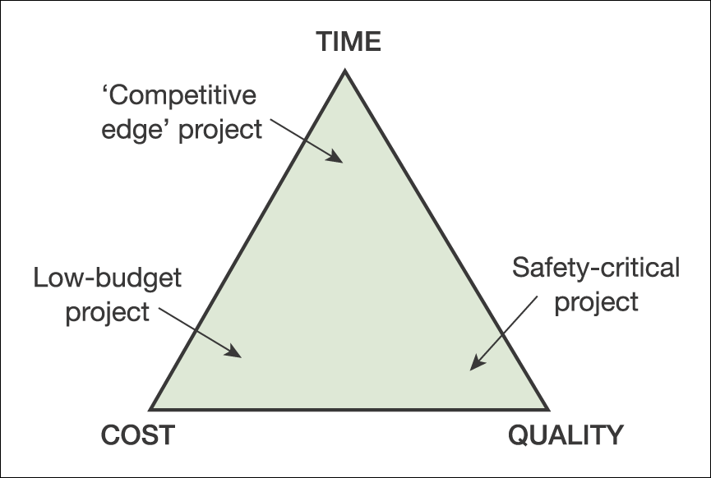
What is project management?
Organizing and managing resources (e.g. people)
…in a way that the project objective is achieved…
…within quality, time and cost constraints
Project completion

Slide 9
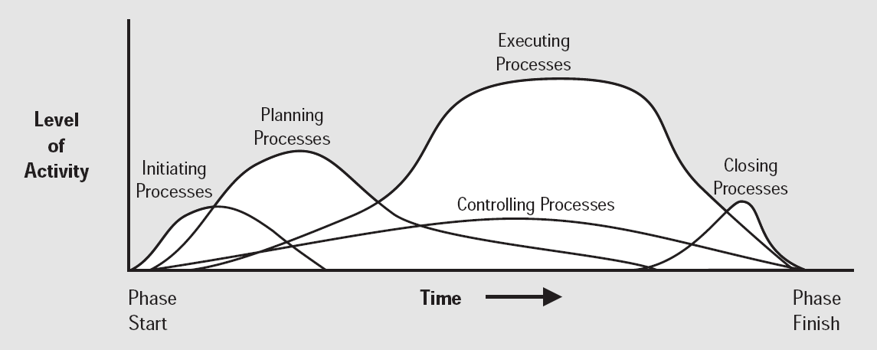
Scope?
Which activities? Duration of activities? Dependencies?
Which resources? Cost of resources?
Scheduling and sequencing of activities?
Schedule control (on time)
Cost control (on budget)
Quality control (with the desired level of quality)

Slide 10
Job of the project manager
Software project planning, addressing issues such as
How to determine the scope of a project?
How to define the required project activities?
How does the software process relate to project management?
How to estimate the required resources?
How to estimate the duration of the project activities?
How to estimate project costs?

Slide 11
Job of the project manager
The execution and control of software projects, addressing issues such as
How to control and change the schedule?
How to control cost?
How to achieve the desired level of quality?

Slide 12
‘Soft skills’are required
A ‘good’ project manager has managerial skills:
Leadership
Ability to communicate (to project team members)
Ability to report (to higher-level management)
Ability to negotiate (with customers)
Ability to keep in control
Problem solving skills
Conflict management skills
…
Hard to learn, but training can help Experience is required to master it

Slide 13
Learning ‘project mechanics’is important
A ‘good’ project manager makes efficient and effective use of the project management ‘toolset’:
Software scoping techniques
Software cost estimation techniques
Project planning techniques
Software project organisation guidelines
Software quality assurance techniques
Project progress monitoring techniques
Can be learned Experience is useful to master it

Slide 14
Standards and certification programs
IEEE PMBOK
Project Management Body Of Knowledge
US
Older
PRINCE2
PRojects IN Controlled Environments
UK
Newer
Not the focus on this course!

Slide 15
Why is SW development different?
Can you think of the biggest difference between building a bridge vs building a SW system?

Slide 16
Why is SW development different?
Can you think of the biggest difference between building a bridge vs building a SW system?
The outcome (end result) is immaterial
Hard for the customers to express their whishes
Hard for the suppliers to capture the whishes unambiguously
Flexibility is required on both side
Revisit the specification
Negotiate…

Slide 17
Why is SW development different?
Innovation factor: large projects are usually “one-off” projects
Different from previous projects
Maturity factor: there are no standard software processes
Dramatic variations from one organization to another
Hard to follow best practices and to predict effort/costs
Human factor: intellectual product, involving creativity
20% of the people do 80% of the job (B. Boehm)

Slide 18

Your experience!
What has been your experience with projects?
Where they successful? Why not?

Slide 19
Types of Information Systems Projects
Ch1

Slide 20
Types of Information Systems (IS) Projects
Software development projects
Smaller IS projects
Package implementation projects
System enhancement projects
Consultancy and business analysis projects
Systems migration projects
Infrastructure implementation projects
Outsourcing and insourcing projects
Disaster recovery projects

Slide 21
Software development projects
A group of people working together to specify, design, develop, test and implement a new system for a customer
Similar to other “construction” projects
Define needs, build, test
As mentioned, intangible product makes the difference

Slide 22
Smaller IS projects
Is it worthy to apply project management?
Balance between work to be done and management work needs to be considered
Beware of too much bureaucracy
Rules of thumb
One document still vital – Project Initiation Document (defines the scope!)
Laying a general project plan is always useful
Monitoring and control should be tailored to the scale of project

Slide 23
Package implementation projects
Existing software package is acquired, installed and switched on
Quicker and cheaper than building a system
If the degree of customization is kept under control (extensive tailoring probably more expensive than bespoke development)
Main difficulties
Selecting the right package (customer)
Tailoring to meet specific needs (supplier)
(Integrating with other systems)
Project management challenge
Keeping the customer realistic in their demands

Slide 24
Consultancy and business analysis projects
Do not involve developing or installing anything tangible
They are about investigating a business issue and proposing solutions using information technology
Main issues:
Shifting the scope (boundaries) of the project
Communicate to the customer what can be achieved within the time and budget constraints
Project manager:
Carefully negotiate budget, timescale, and scope with the customer (flexibility)
Notes:
The investigation work itself may reveal that the original boundaries of the project have been drawn too narrowly and will have to be expanded if worthwhile results are to be achieved

Slide 25
System enhancement projects
The users of an existing system want new features
Or perhaps to meet some external demand, e.g., compliance with legislation or regulations
Often handled as “business as usual” by the maintenance team but can involve a lot of work, time, and high costs
Main issues for the project manager:
Not breaking the existing features (regression testing)
Sharing technical staff time between enhancements and day-to-day support

Slide 26
Systems migration projects
Moving existing system to new platform:
an existing operational system has to be moved to a new operating environment
May involve
Some software development
Some infrastructure
Some retraining of users
Users judge the process success by
the smoothness/ of the transition (SEAMLESS)
lack of interruptions to their workload

Slide 27
Infrastructure projects
Installation/substitution of hardware to put in place communications networks
The fitting out and equipment of a new office building
General project management principles apply
Advantage: the output of this kind of project is tangible
Specific issues to consider:
Supplier management is vital:
Delivery time, tasks interdependency, time, effort, money

Slide 28
Outsourcing projects
Main reasons for going down the outsourcing route are:
The wish to gain access to the expertise of the outsourcing providers
Difficulty in managing the IT estate internally
A desire to reduce costs, through economies of scale or by taking advantage of lower labour costs elsewhere.
Involves for instance:
“Due diligence” in handing over systems (clear and feasible scope of contract)
Training new people to support systems
Taking inventories of assets transferred/retained
Migrating contracts of employment
Renegotiating supplier contracts

Slide 29
Disaster recovery projects
Can be triggered by wide range of threats
Always involves tight timescales
Organization needs to get its systems back up and running as soon as possible having continuity of the business
Prevention is always better than curing
Pre-planning is vital for success and includes:
Well thought-out plan
Arrangements with DR services suppliers
Other arrangements, e.g., for the use of offices
Up-to-date lists of key personnel
Equipment stored and accessible for use
Drills and practice deployments
Main challenge for manager:
keeping cool head “Do not panic” and skills for planning

Slide 30
Development Lifecycle
Ch6

Slide 31
Relationship with project management
Very often, the project manager cannot choose the type of software process
Process is a given
Company has invested in training the developers in a certain way
Unless there is a goal to explore alternatives for the future

Slide 32
Relationship with project management
Obviously, awareness of construction activities (to plan!)
Technical milestones
Type of process and approach (traditional vs agile) has impact on planning and scheduling
Will be more evident later…
Development practices have impact on cost estimation
Build vs buy COTS
Development practices have impact on division of work
E.g., easier with component-based

Slide 33
However…
Project does not span entire life-cycle
Excluding maintenance
Only a feasibility study, or requirements analysis…
Life-cycle only covers the technical deliverables!
Cost control activities?
Reports to the management?

Slide 34
Development lifecycle models
Waterfall model
B model
V model
Incremental model
Spiral model
Agile
A bit of history…
Traditional approach
Unstructured
Lack of user involvement
No business case or acceptance criteria
Structured systems development
Greater user involvement at all stages; driven by users

Slide 35
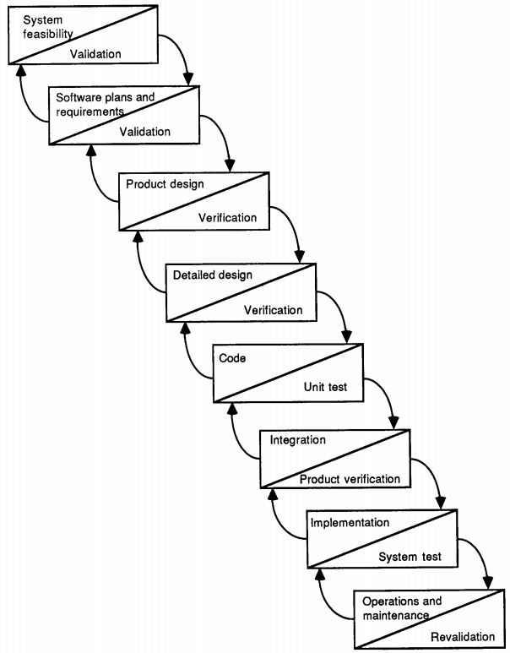
Waterfall model

Slide 36
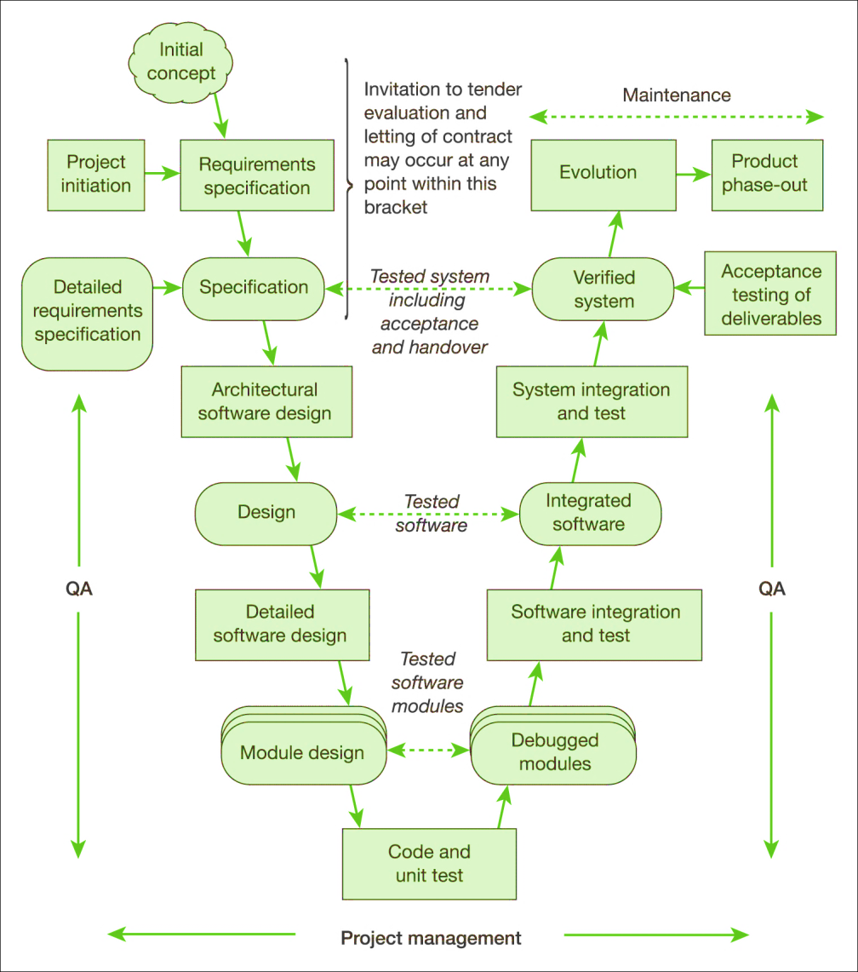
The ‘V’ model
Variation stressing the role of verification and validation
Downward: breaking down of the product
Upward: assembly
Correspondences between the stages

Slide 37
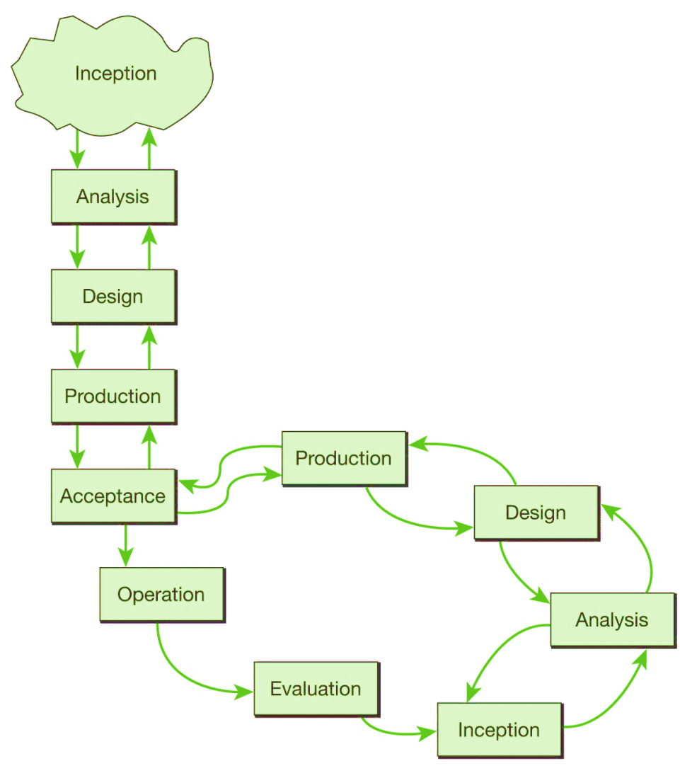
The ‘b’ model
Maintenance is different in nature from the other stages
It is ongoing and open-ended
70% of total lifecycle costs

Slide 38
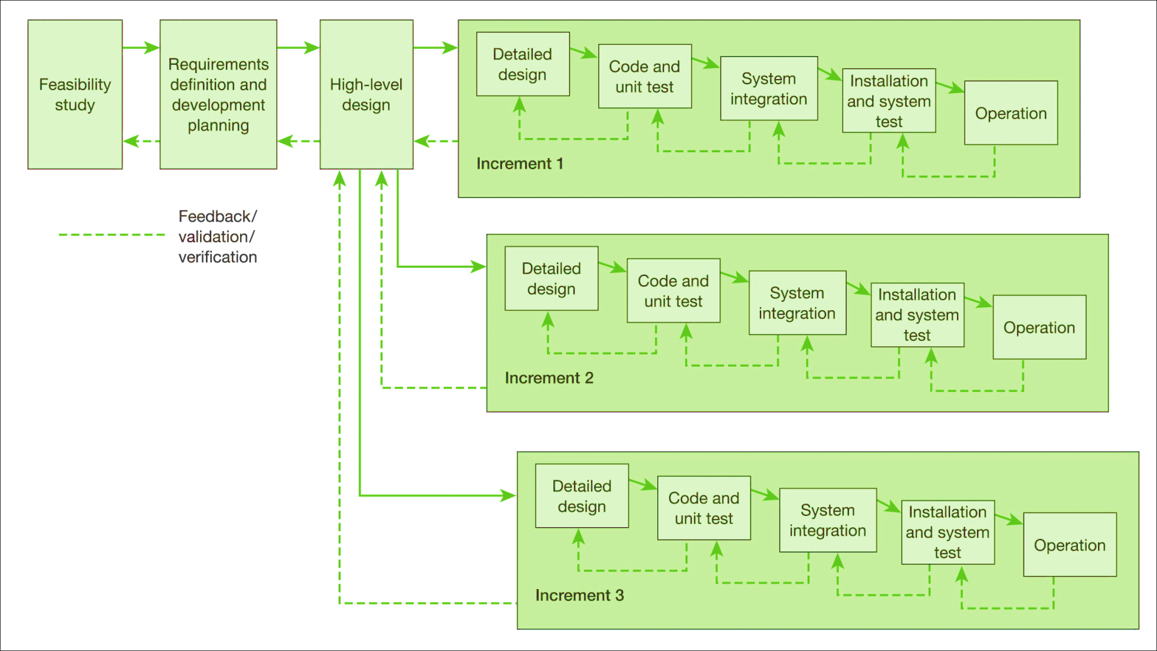
The incremental approach
Not a prototype !
Phased delivery

Slide 39
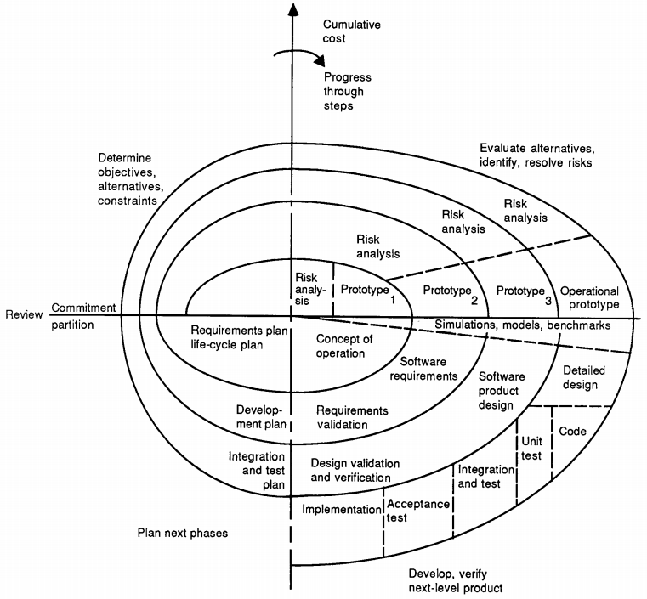
The spiral model – evolutionary development
Often, requirements are not well formed or understood by the users
Risk analysis
Planning
Evaluation
Engineering
Boehm’s spiral model
Source: © 1988 IEEE

Slide 40
Unified Process
Are you familiar with UP?
Approach ‘open’, i.e., non-proprietary, but Rational Corporation offers Rational Unified Process (RUP)
Four phases to process
Inception, Elaboration, Construction, Transition
Each phase has five workflows
Requirements, Design, Implementation, Assessment, Deployment
More details later…
Used later, in planning

Slide 41
Agile approaches
Addresses weaknesses of other approaches
Too much upfront work for something that is elusive in nature (the user requirements)
More flexible, more quick results
Iteration and rework are seen as being an integral part of the agile approach and not something to be avoided if possible
All changes reversible
Embrace the spiral model development lifecycle
Higher number of iteration (incremental delivery)

Slide 42
Agile approaches
Use of prototypes to
assist users define requirements
test performance implications
investigate novel methods of working
assist in considering work practices
Testing is integral to iterative lifecycle
Different management culture
Success dependent on empowerment of users and developers (and not on strict, bureaucratic management)
Time-boxing used to control timescale (and budget)

Slide 43
Extreme programming (XP)
Created to deal with rapidly changing requirements
Tighter integration and communication with the customer
Emphasis on frequent releases of small-scale packages of software
Practices
Developers work in pairs
Testing – integral part of process (test-first)
Simple and clean code, refactoring
Works best on relatively small projects or on enhancements to existing systems

Slide 44
SCRUM
Scrum is an example originated in USA
Development done in 30-day “Sprints”
End everything is time-boxed
Project manager called “ScrumMaster” has a different role from the usual PM role
He/she is a facilitator and helper
The teams are self-governing (flatter structure)
Scrum includes 15 minutes daily meeting to review progress and reset priorities

